Slide 1

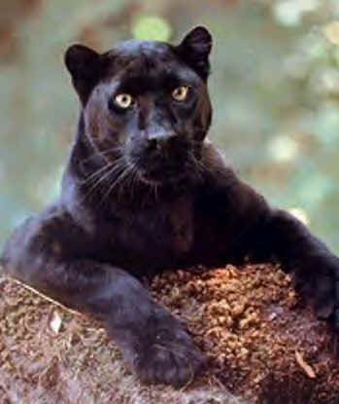
Back To School Night
MRS. Gutierrez’s
FOURTH GRADE CLASSROOM

Slide 2
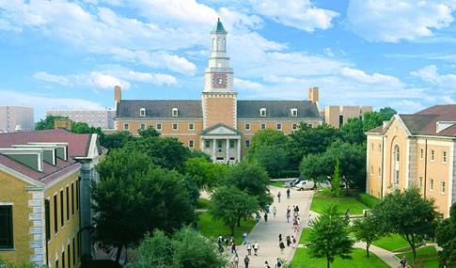
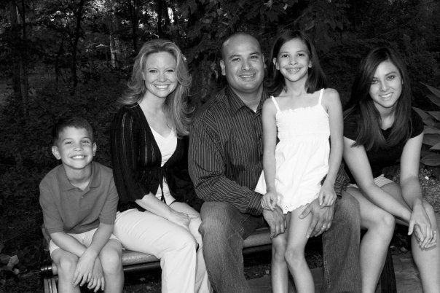

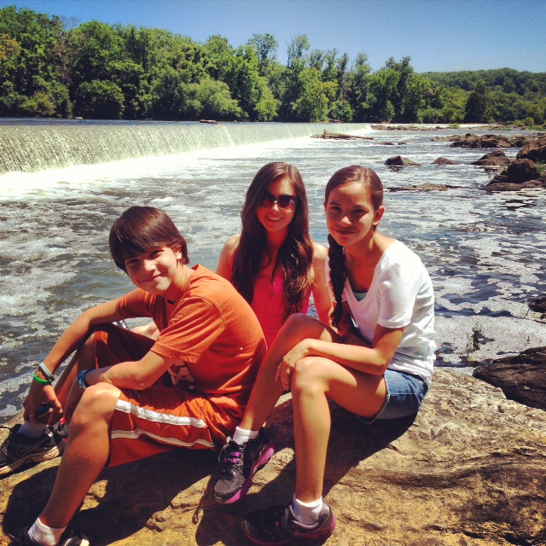


Slide 3
Weekly Schedule
Monday
Music 8:00-8:30
Computer 12:30-1:00
Tuesday
PE**** 8:00-8:30
Library 8:30-9:00
Wednesday
Music 8:00-8:30
Computer 8:30-9:00
Thursday
PE 8:00-8:30
Art 9:00-9:45
Friday
PE***: 8:00-8:30
Buddies: 11:00-11:40
EVERYDAY
Reading / Writing Workshop
Math
Science or Social Studies – alternating units
Lunch: 11:40-12:10
Recess: 12:10-112:30
***Appropriate dress and shoes for PE days are required.

Slide 4
Parent Communication
In order to provide the best education possible for your student, we need to work as a TEAM.
There several lines of communication available.
  Email (preferred)
  Notes
  Friday Folder
  Agenda
  Scheduled Conferences
  School Phone
Before leaving tonight, please add your contact information on the class directory!

Slide 5
Parent Conferences
The sign-up schedule for parent conferences is on the back table.
Conferences will be scheduled for the last two weeks in October just as the 1st quarter is coming to a close.
Any conferences before or after that will be either parent requested or teacher requested

Slide 6
Scholastic Book Orders
In our classroom, I will be distributing Scholastic Book Flyers on a monthly basis.
If you are interested in participating in this book club program, you have the option of ordering through the classroom or online. Orders placed online will ship faster ☺
Whether ordering online or by check, ordering through Scholastic provides the classroom with points and coupons that I can use to get free books for the classroom. (Which we all love!)

Slide 7
Newsletters
Each month a grade level newsletter is sent home.
I will also be sending home a newsletter about the events in our class, and ways you can help your student at home.

Slide 8

Be a PAWSitive part of the Pride:
Our school is a PBIS (Positive Behavior Intervention and Support) school, and this is our slogan.
Students earn individual tickets when they are “caught being extra good.” If their name is drawn from the grade level drawer, they go on the morning show for recognition and a reward.
Whole classes can also earn tickets for a classroom reward.

Slide 9
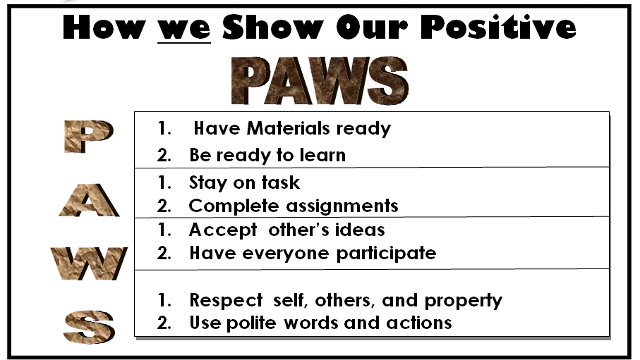
How we show our PAWS in fourth grade:

Slide 10
Behavior Expectations
Love and Logic Classroom
Students will have a reminder of our grade level and class expectations
* Students will then develop a plan of action to avoid the behavior – this is done privately with the teacher.
* If behavior persist the parent will be contacted through the communication folder.
Students will then reflect on their plan at home and decide what will be different tomorrow.

Slide 11
Homework Policy
Homework is given most every day Monday through Thursday.
The homework policy for Loudoun County Schools is that a fourth grader have no more than one hour of homework a night.
If homework is not completed or left at home, a student will lose a panther paw and a notice will be stapled to their agenda for you to sign. PLEASE initial their agenda each night after your child completes their homework.
If assigned homework is taking more than an hour a night, please contact me so we can solve this problem.
If a question arises on homework that you or your student are unable to answer, have your student put a question mark next to that particular question and put your initials next to it. We will go over it in class.

Slide 12
Grading & Report Cards
4
Exceeds
More Complex Concepts
3 – Learning Target
Meets the Standard
2 – Simpler Concepts, Progressing Toward Standard
1 – Building Blocks, Below Standard

Slide 13
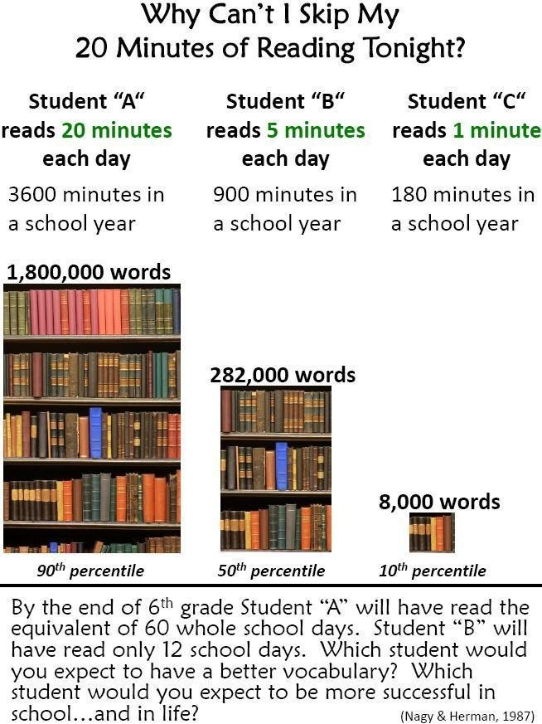
Reading 20 minutes each night…

Slide 14
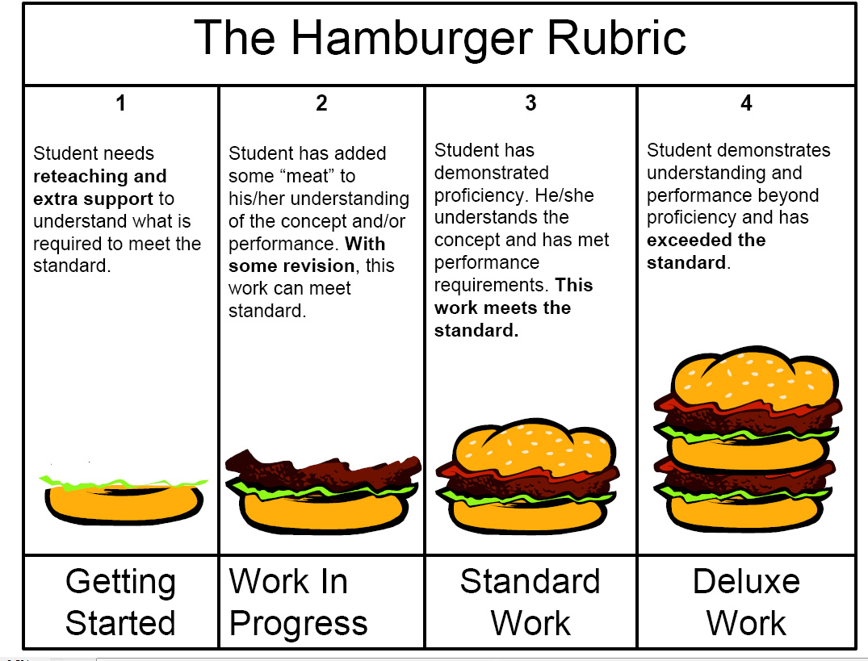
Another way of looking at it…

Slide 15
Grading Policies & Procedures
Students will receive letter grades and number grades on each graded assignment.
Students will be receiving effort grades in all subject areas.
Grading Key:
A = Outstanding
B = Good
C = Satisfactory
D = Needs Improvement
F = Not Performing
Progress Indicators:
4 = Exceeds Standard
3 = Meets Standard
2 = Progressing Toward Standard
1 = Below Standard
O = Outstanding
S = Satisfactory
N = Needs Improvement

Slide 16
SOL Testing
SOL Testing will begin in early-mid May.
4th graders will take the following SOL tests:
  Reading
  Math
  Virginia Studies

Slide 17
First Nine Weeks Plans
Reading
  Context Clues
  Dictionary/Thesaurus
  Author’s Purpose
  Summarizing
  Inferencing
Writing/Language Arts
  Organize/Plan Writing
  Focus on a Topic
  Using Nouns/Adjectives
  Noun-Pronoun Agreement
Science
  Scientific Method
  Virginia’s Natural Resources
Math
  Place Value
  Rounding/Estimation
  Addition/Subtraction
Social Studies
  Virginia Geography
  First Americans
  Early Jamestown

Slide 18
Miscellaneous
Sign up before you leave
    Parent – Teacher Conference
    Classroom Volunteers: will start the month of Mid September
Change in Dismissal:
  Please always write a note or call the office (if needed mid-day).
Birthdays :
  I am only permitted to pass out invitations if there is one for every child in our class.
  Only non-food treats will be allowed at school: NO CUPCAKES.
Wish List
* 1” Binder, Boogie Boards

